Slide 1
Exploring data technologies using free tools
Phil Austin and Dom Winsor, October 2024

Slide 2
Purpose & Goals
An overview, with demos, of how to develop your data skills using free tools for data manipulation, visualisation and transformation using languages like SQL and Python in the cloud and on your Windows laptop.
Gain Insight: Applied Data Engineering
Enable Self-study: Tools & Resources

Slide 3
Format
Talk focused on demo’s - questions at the end
Write questions on cards
Read yours out at the end
Add cards to the table in the break
Have an answer, or a tip?
Use a card to answer and place next to the corresponding question
Place tips on relevant area on table

Slide 4
In this session
Intros & Overview
Working with data
In the cloud (Azure storage accounts; ADF)
Intro to VS Code
Azure Data Factory setup
Databricks -setting up & demo notebook
Using free software on a Windows Laptop (PySpark)
Quick SQL & Python getting started locally demo
Topics
Getting setup
Data basics
Data Engineering techniques

Slide 5
About Us

Slide 6
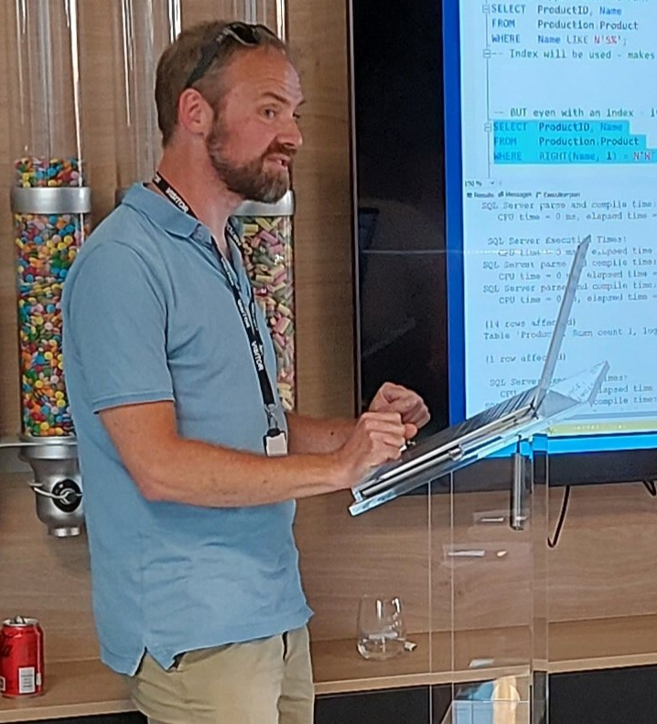

Phil Austin
Senior Consultant
Data & AI

Slide 7
Dom Winsor
Career includes tech design, development, management & support roles ranging from Data Engineering to Front-End Web Solutions. Currently a…
Product Manager
Working for the UK Civil Service, on Data Integration Platforms

Slide 8
Scope
Supporting tools
Code editing
Database Access
Cloud overview
Environment setup pointers
Working with some data (acquire, manipulate, present)
Offline
Running a local database & Python/PySpark environment
Working with some data (acquire, manipulate, present)

Slide 9
Demo’s

Slide 10
Azure
Go to Azure.com
Click ‘Try Azure for free’
You will need:
An email address
A mobile phone
A credit/debit card – don’t worry you won’t be charged!
Choose United Kingdom or US region
$200 credit / 30 days
Some resources are free longer / permanently
Notes:
DOM

Slide 11
Data engineering using your free credits
Notes:
PHIL

Slide 12
Data engineering using your free credits
Resource group
Notes:
PHIL

Slide 13

Data engineering using your free credits
File
Resource group

Slide 14

Data engineering using your free credits
File
Data Factory
Resource group

Slide 15

Data engineering using your free credits
File
Data Factory
Storage Account
Resource group

Slide 16

Data engineering using your free credits
File
Data Factory
Storage Account
Databricks
Resource group

Slide 17
VS Code

Slide 18
VS Code
Free download

Slide 19
VS Code
Free download
Lightweight

Slide 20
VS Code
Free download
Lightweight
Very large number of plug-ins/extensions – most free

Slide 21
Azure CLI

Slide 22
Azure CLI
Install by following links from: https://learn.microsoft.com/en-us/cli/azure/install-azure-cli

Slide 23
Azure CLI
Install by following links from: https://learn.microsoft.com/en-us/cli/azure/install-azure-cli
VS Code extensions:
Azure CLI Tools
Azure Developer CLI

Slide 24
Demo

Slide 25
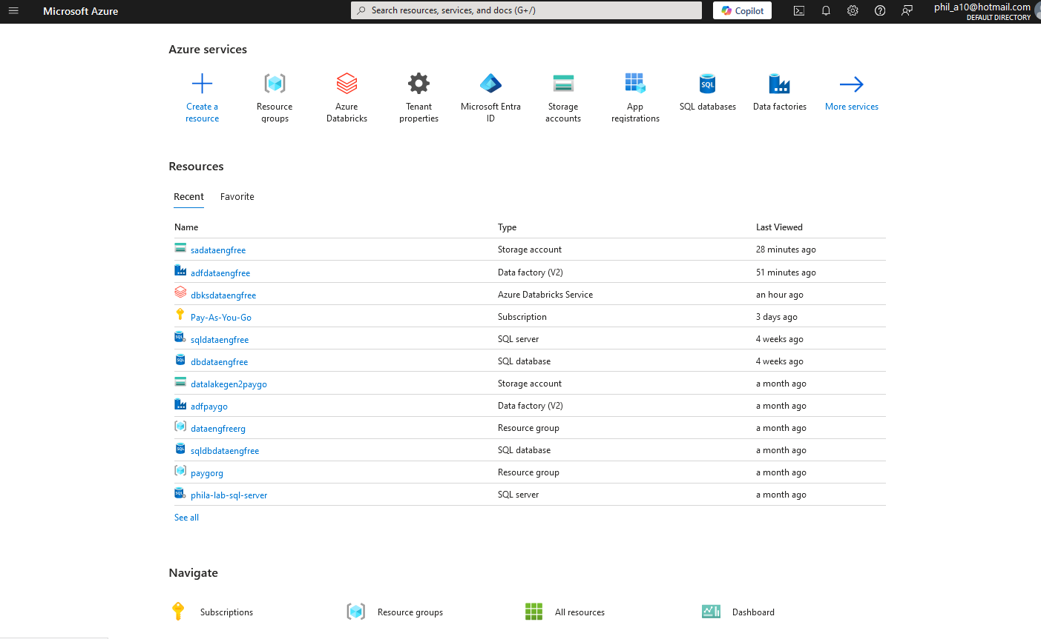
Azure Portal

Slide 26
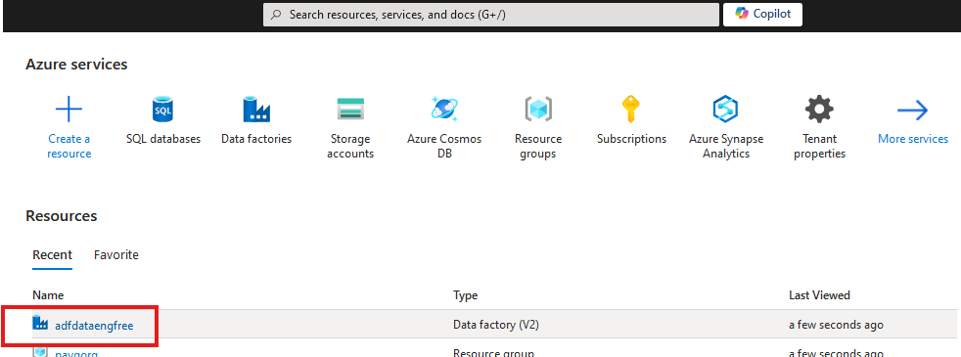
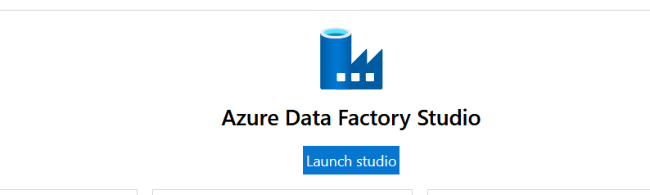

Slide 27
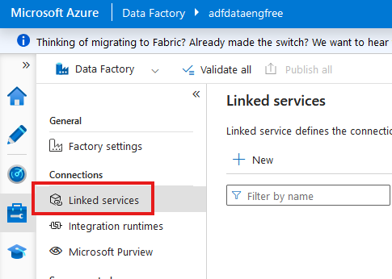

Slide 28
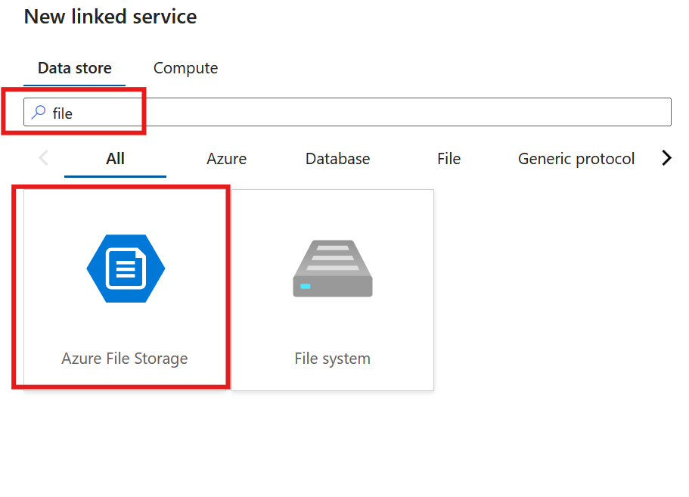

Slide 29
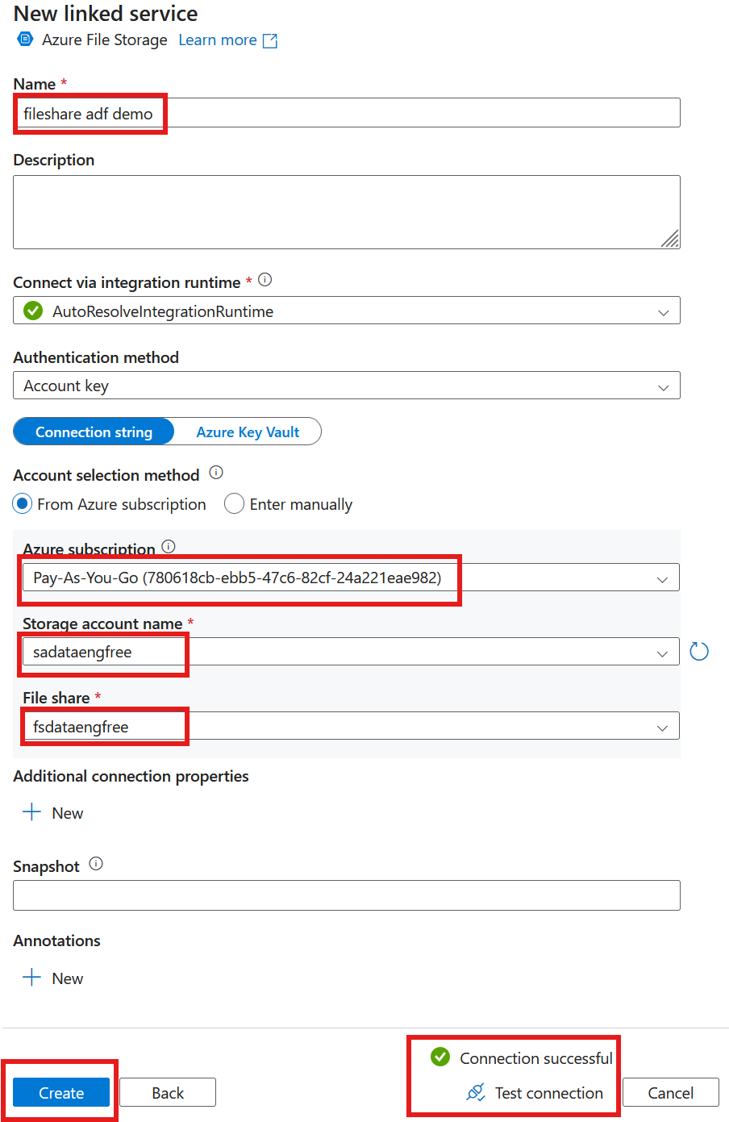

Slide 30
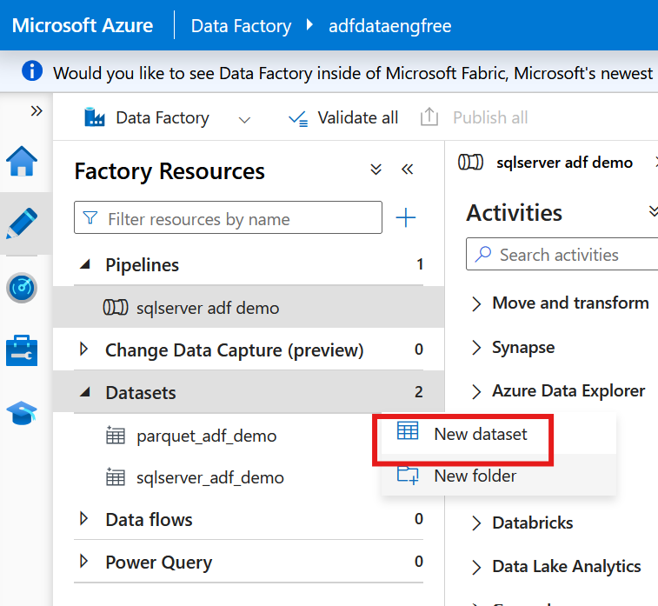

Slide 31
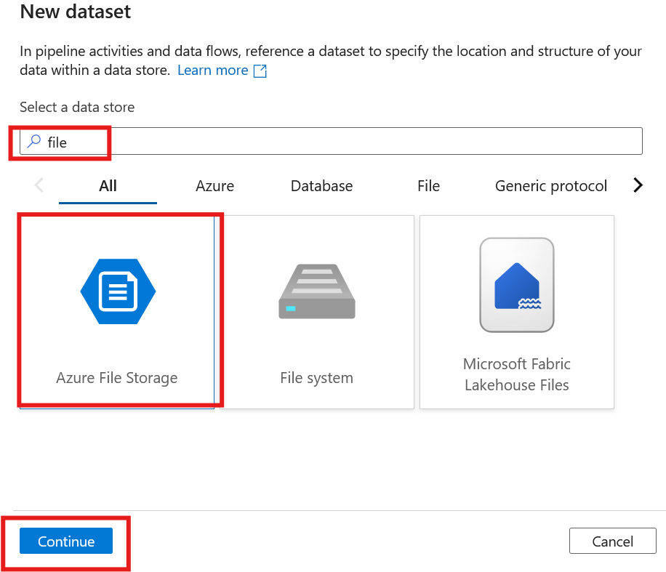
Notes:
S

Slide 32
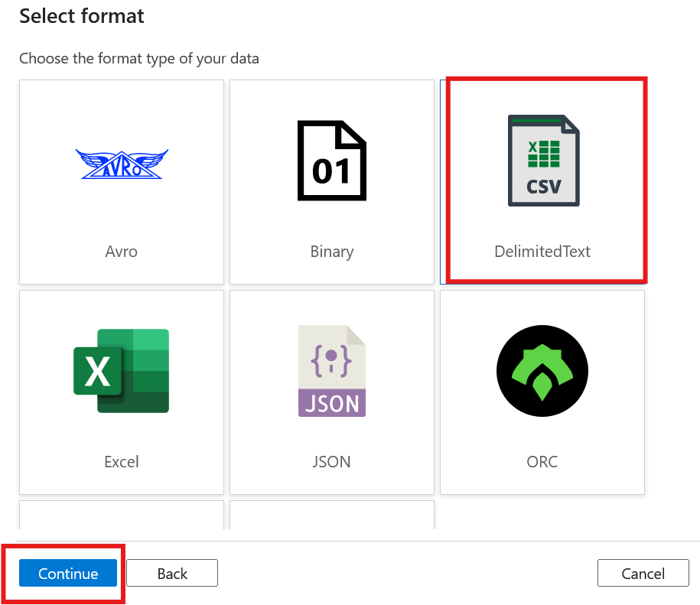

Slide 33
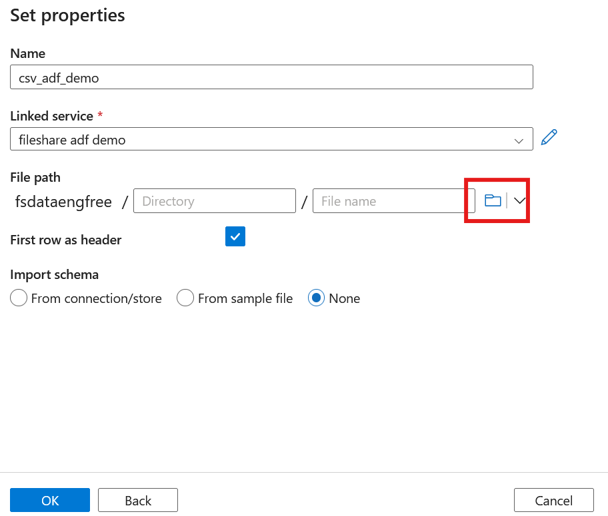
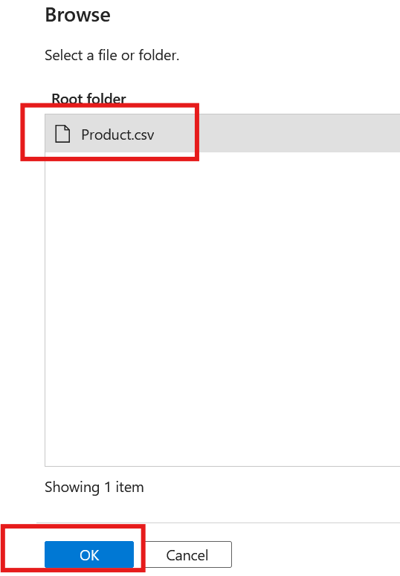

Slide 34
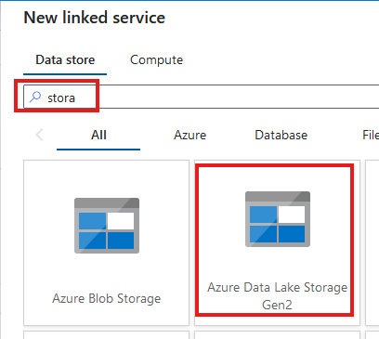
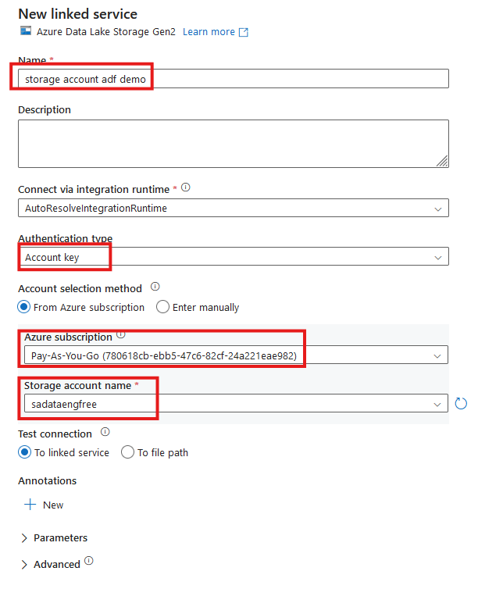


Slide 35
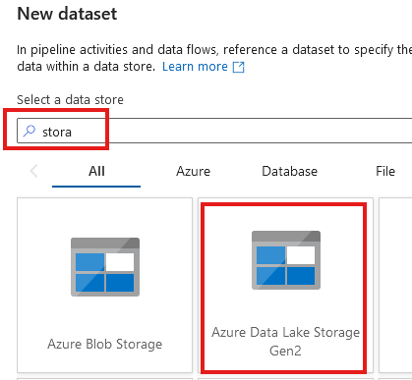
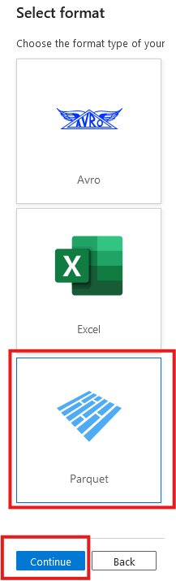

Slide 36
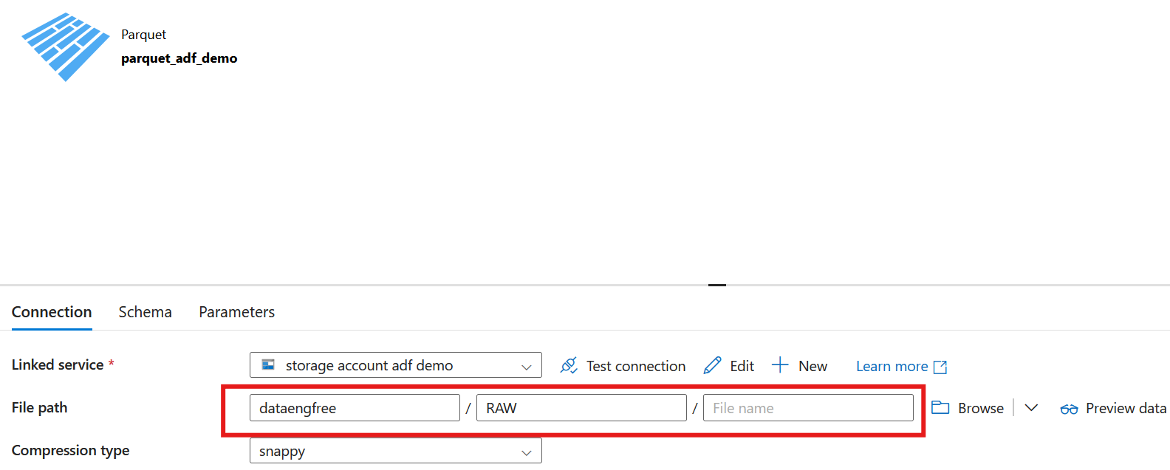

Slide 37
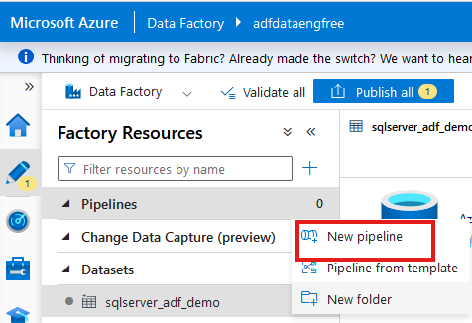
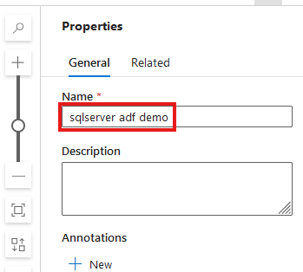

Slide 38
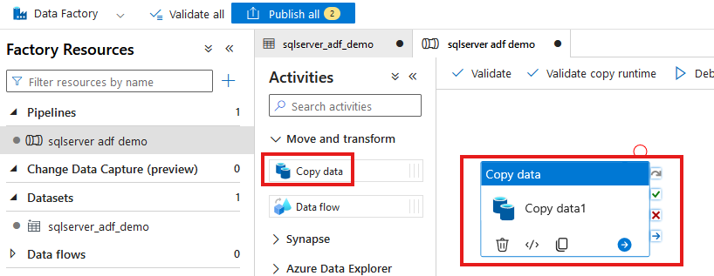

Slide 39
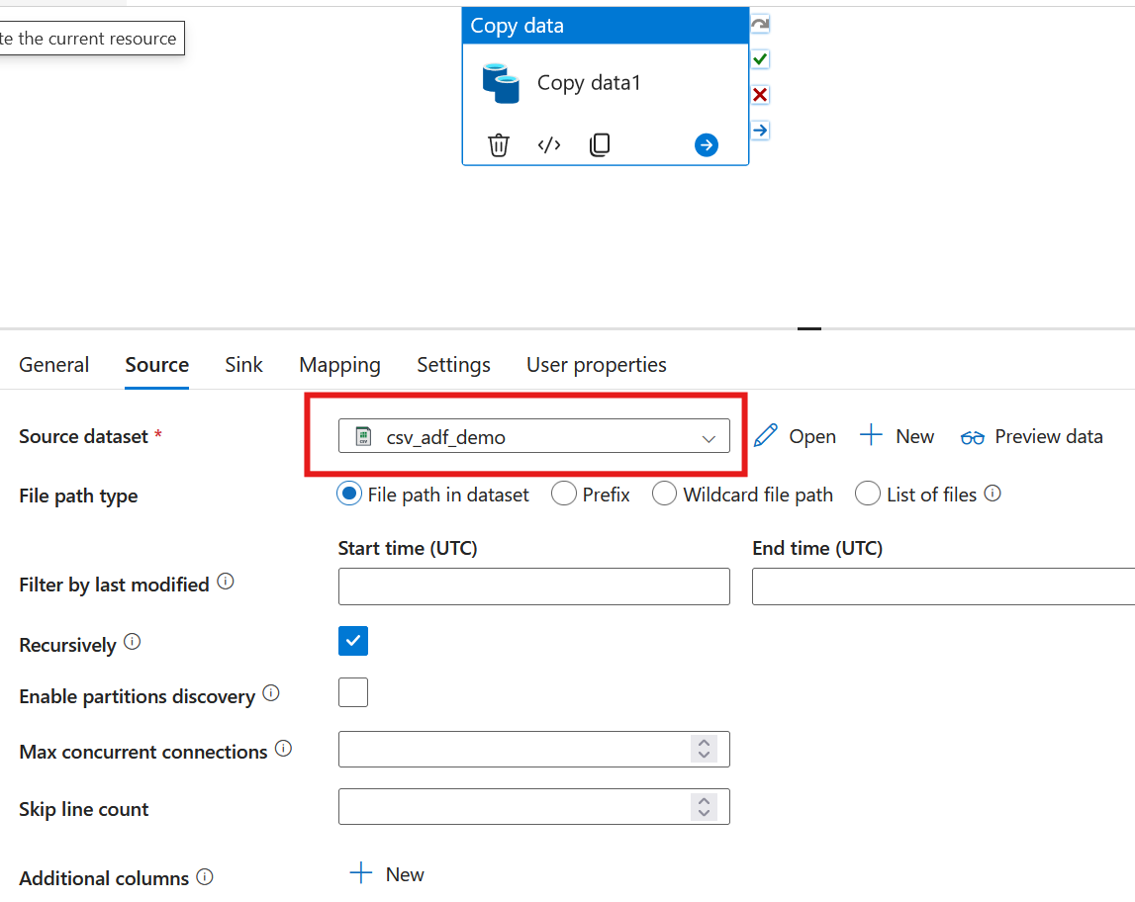

Slide 40
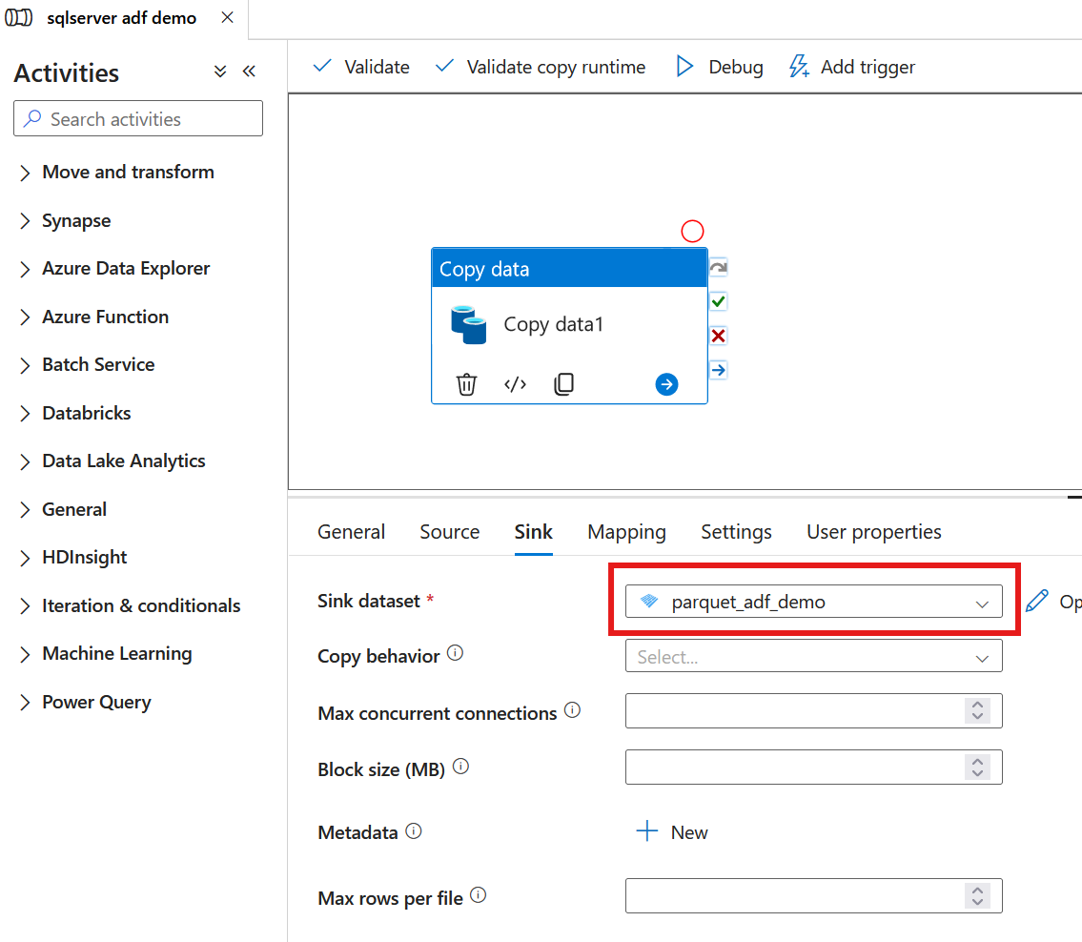

Slide 41
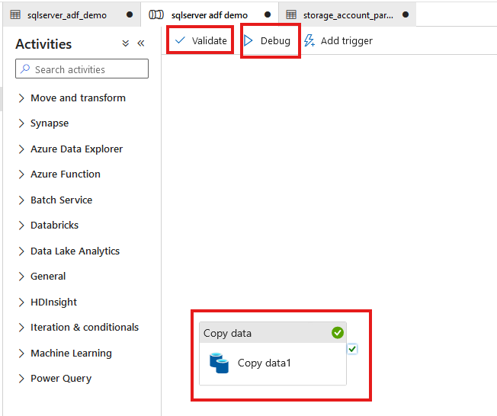

Slide 42
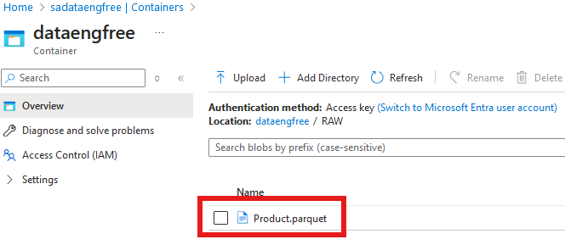

Slide 43
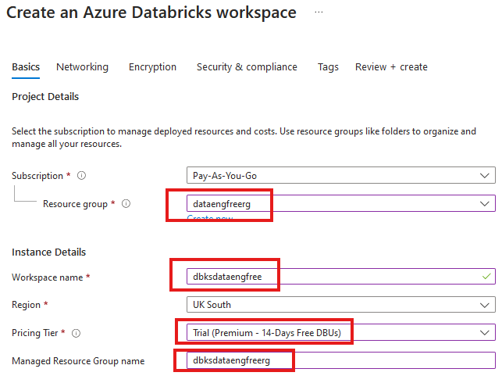


Slide 44
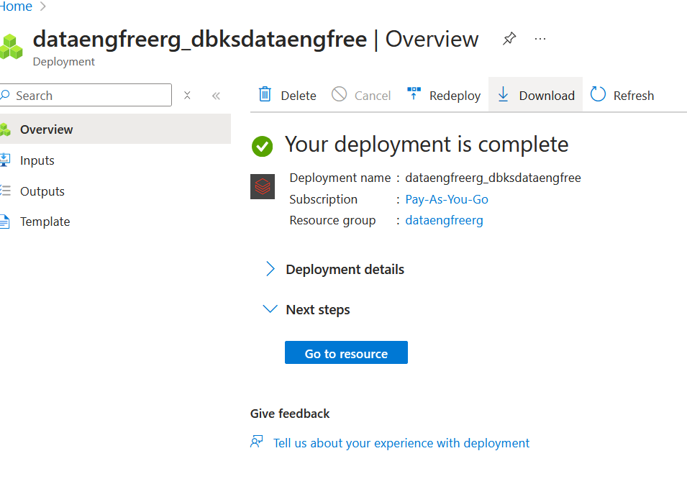

Slide 45
Azure CLI Part II

Slide 46
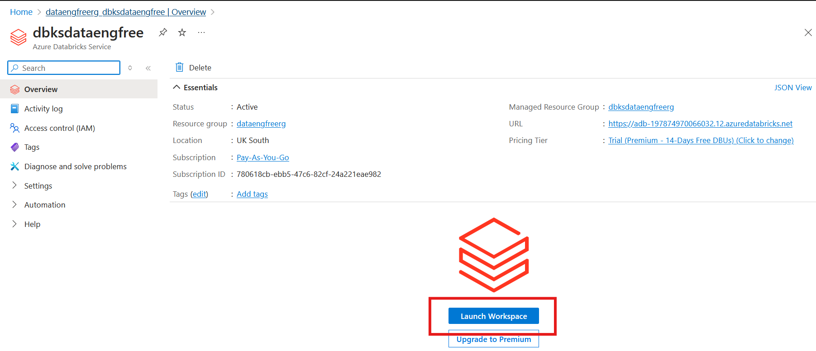

Slide 47
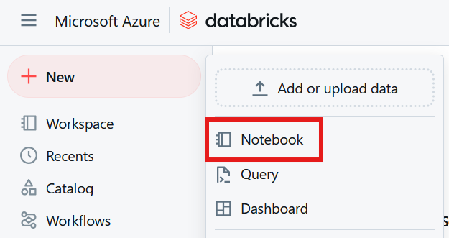

Slide 48
Databricks Demo

Slide 49
Data Engineering locally

Slide 50
Python
What is Python?

Slide 51
Python
What is Python?
Use Anaconda

Slide 52
Python
What is Python?
Use Anaconda
Use conda to create environment

Slide 53
Python
What is Python?
Use Anaconda
Use conda to create environment
Might need to enable Long Paths

Slide 54
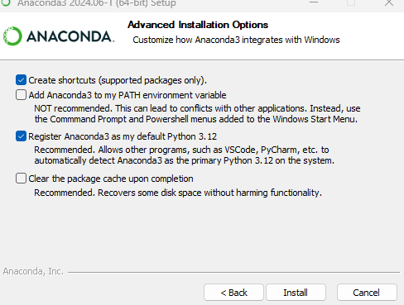
Anaconda install

Slide 55
Conda demo

Slide 56
Apache Spark
Spark

Slide 57
Apache Spark
Spark
PySpark

Slide 58
PySpark Pre-requisites
Install Java v17

Slide 59
PySpark Pre-requisites
Install Java v17
Set paths in environment variables
JAVA_HOME
PATH

Slide 60
PySpark Pre-requisites
Install Java v17
Set paths in environment variables
JAVA_HOME
PATH
Install Apache Spark v3.5.3

Slide 61
PySpark Pre-requisites
Install Java v17
Set paths in environment variables
JAVA_HOME
PATH
Install Apache Spark v3.5.3
Install winutils.exe

Slide 62
PySpark Pre-requisites
Install Java v17
Set paths in environment variables
JAVA_HOME
PATH
Install Apache Spark v3.5.3
Install winutils.exe
Create virtual environment

Slide 63
PySpark Pre-requisites
Install Java v17
Set paths in environment variables
JAVA_HOME
PATH
Install Apache Spark v3.5.3
Install winutils.exe
Create virtual environment
Install pyspark

Slide 64
PySpark Pre-requisites
Install Java v17
Set paths in environment variables
JAVA_HOME
PATH
Install Apache Spark v3.5.3
Install winutils.exe
Create virtual environment & install python
Instructions: https://sparkbyexamples.com/pyspark-tutorial/

Slide 65
PySpark Demo
Uses VS Code
Notes:
PySpark validation
Web UI
VS Code
- to run Jupiter notebooks needs ipykernel installed
- from vscode run conda install -n dataengforfree_env ipykernel
- copy python.exe > python3.exe
Visualisation?

Slide 66
PySpark Demo
Uses VS Code
Needs Jupyter package installed
conda install jupyter
pip install jupyter
Jupyter extension
Notes:
PySpark validation
Web UI
VS Code
- to run Jupiter notebooks needs ipykernel installed
- from vscode run conda install -n dataengforfree_env ipykernel
- copy python.exe > python3.exe
Visualisation?

Slide 67
PySpark Demo
Notes:
PySpark validation
Web UI
VS Code
- to run Jupiter notebooks needs ipykernel installed
- from vscode run conda install -n dataengforfree_env ipykernel
- copy python.exe > python3.exe
Visualisation?

Slide 68
Quick-start SQL and Python
Tools
VS Code
Sql Server Management Studio (SSMS)
Applications
Python
SQL Server Express

Slide 69
Quick-start SQL and Python
In SSMS
Use Microsoft sample Database ‘Adventure Works’
Using SQL code to join data tables/create views
Using Import/Export Wizard, export a CSV of the views
In Python via VS Code
Import CSV
Plot a chart using Plotly
Load CSV using Pandas, and plot a chart with Plotly

Slide 70
Follow-up Resources
Microsoft Learn: https://learn.microsoft.com/en-us/training/career-paths/data-engineer
PySpark instructions: https://sparkbyexamples.com/pyspark-tutorial/
Kimball: https://www.kimballgroup.com/
Downloads
Azure CLI: https://learn.microsoft.com/en-us/cli/azure/install-azure-cli
VS Code: https://code.visualstudio.com/
Java: https://www.java.com/download/ie_manual.jsp
Apache Spark: https://spark.apache.org/downloads.html
Winutils: https://pypi.org/project/WinUtils/

Slide 71

References
https://github.com/phil-a10/Talks
/Data Engineering Using Free Tools
This deck
Quick-start instructions
Supporting files

Slide 72
END
(Slides cut from in-person talk follow…)

Slide 73
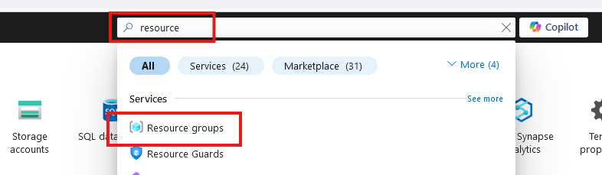
Create Resource Group

Slide 74
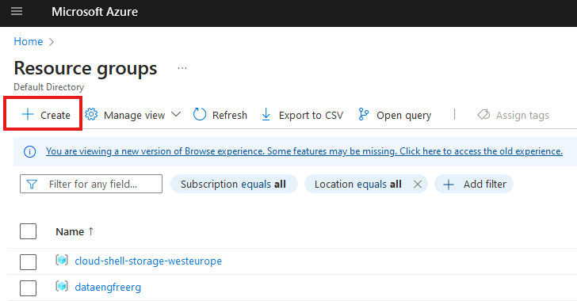
Create Resource Group

Slide 75
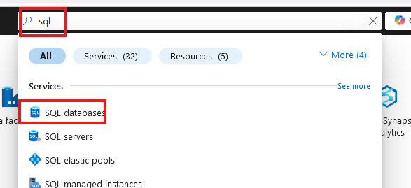
Create SQL database

Slide 76
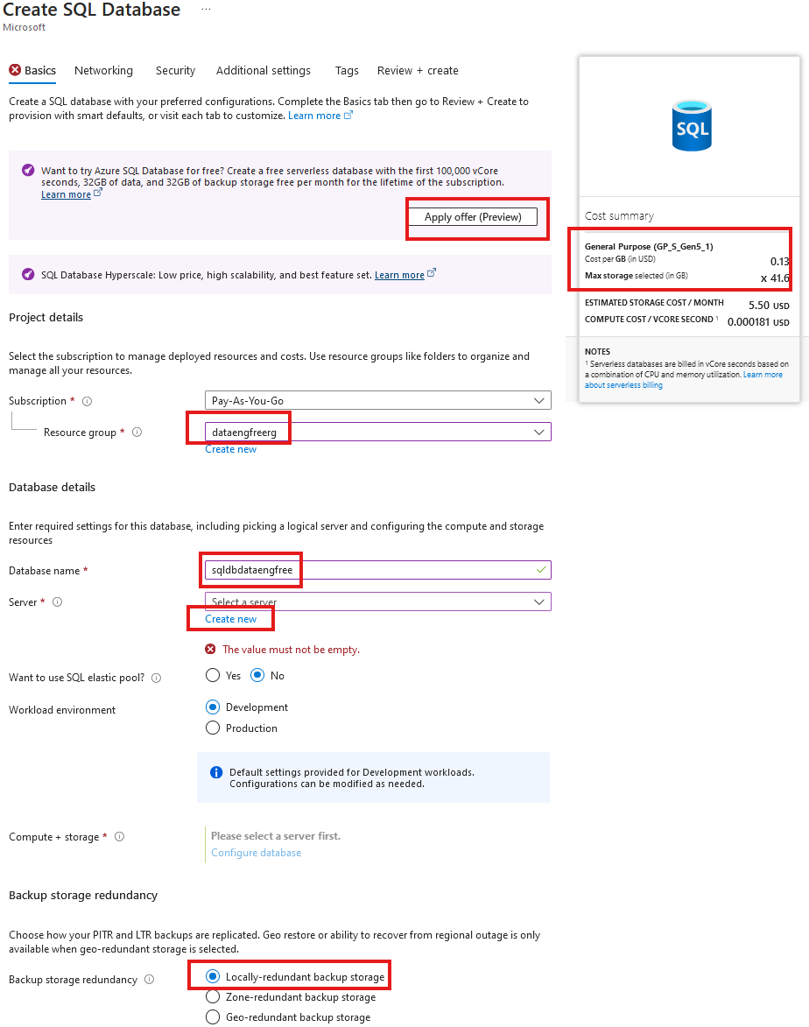
Create SQL database

Slide 77
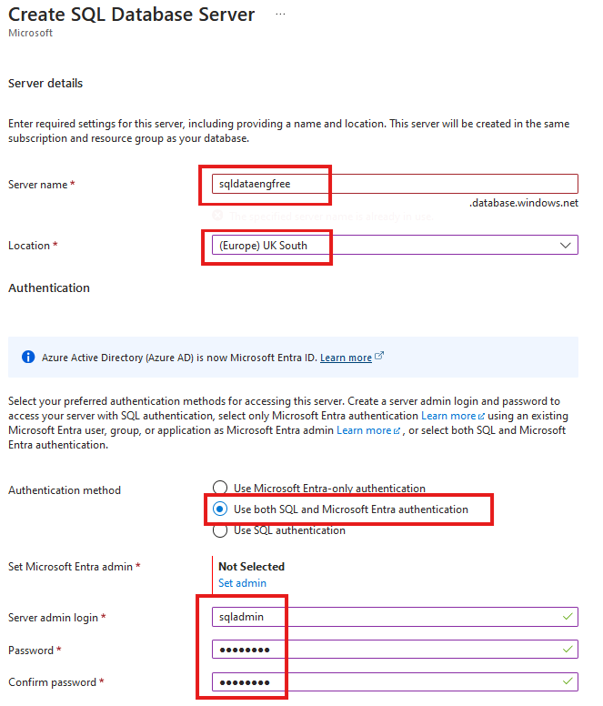
Create SQL database

Slide 78
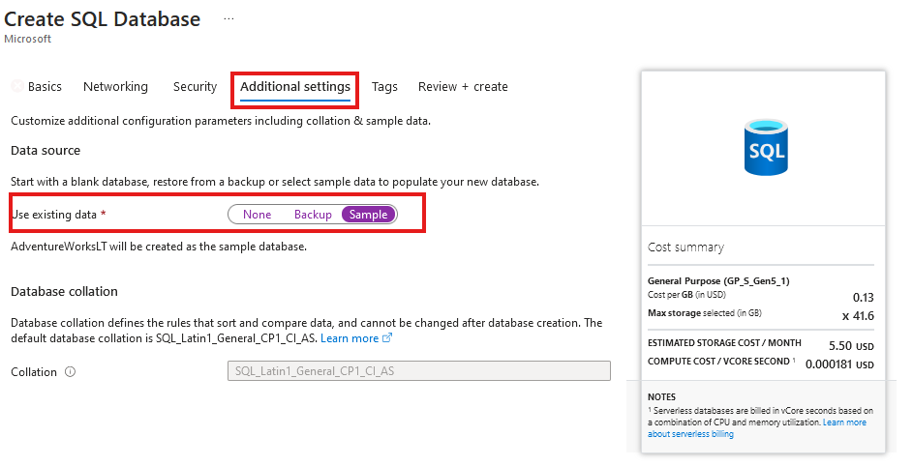
Create SQL database
Add sample data

Slide 79
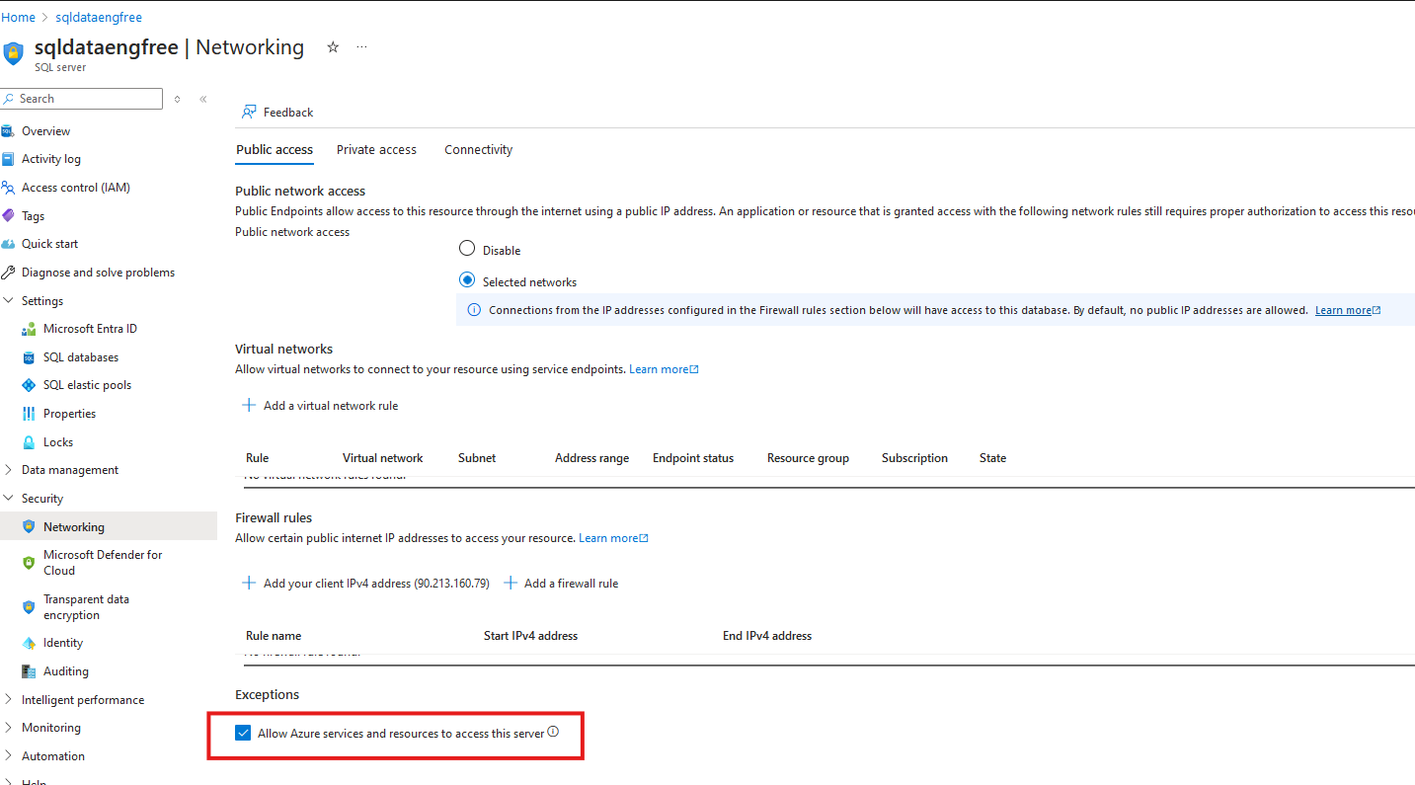
Network setting

Slide 80
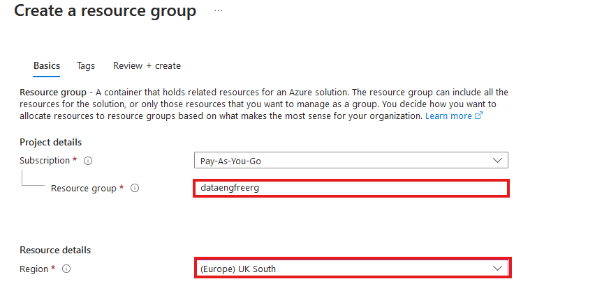
Create Resource Group

Slide 81
Azure CLI Demo

Slide 82
Create storage account
Create in same region as RG
Primary service is ADLS Gen 2
Primary workload Big Data Analytics
Performance: Standard
Redundancy: LRS
Add container > RAW directory

Slide 83
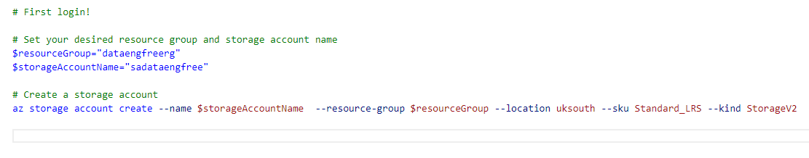
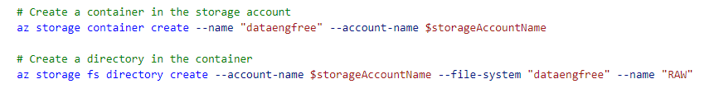
Create storage account

Slide 84
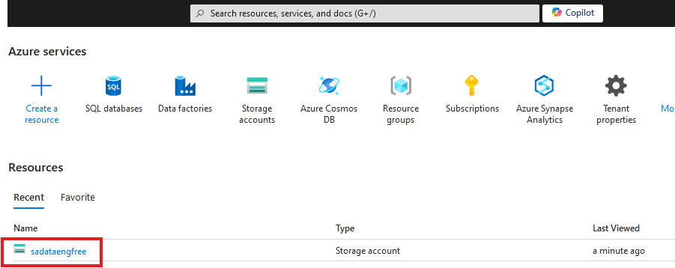

Slide 85
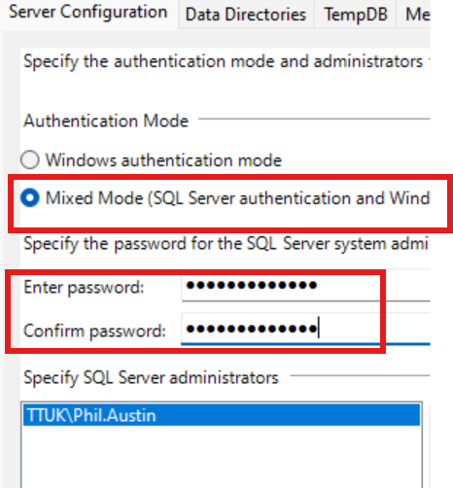

Slide 86
Create Azure Data Factory
Create in same region as RG

Slide 87
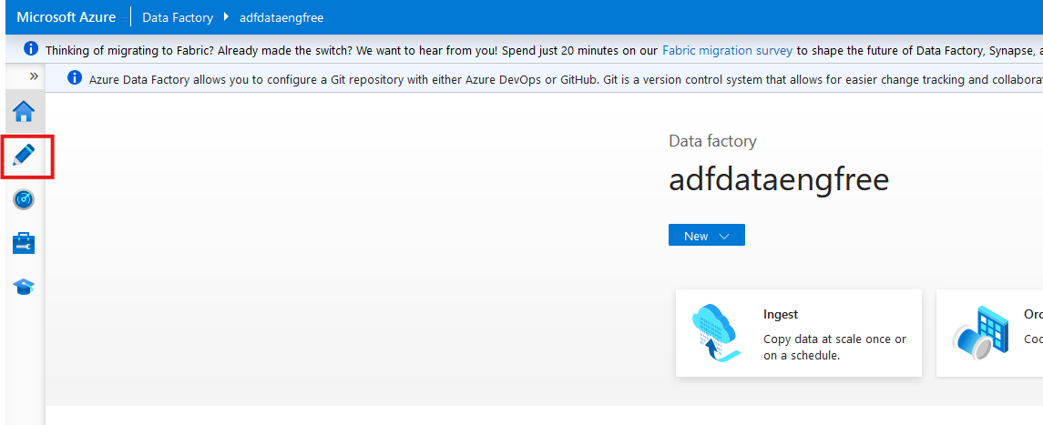

Slide 88
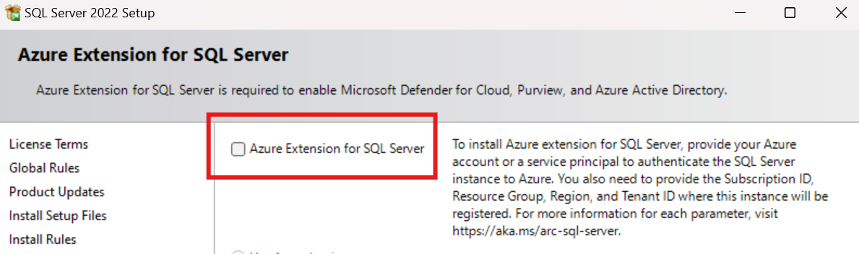
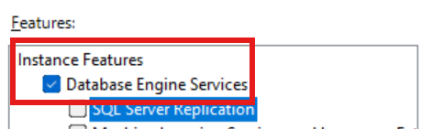
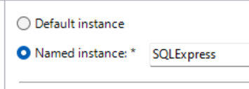

Slide 89
Data & Databases
Concepts to Learn: Data types, databases (SQL and NoSQL), data structures.
Tools/Resources:
Azure SQL Database - free tier available
Cosmos DB: Explore NoSQL databases with a limited free tier on Azure.

Slide 90
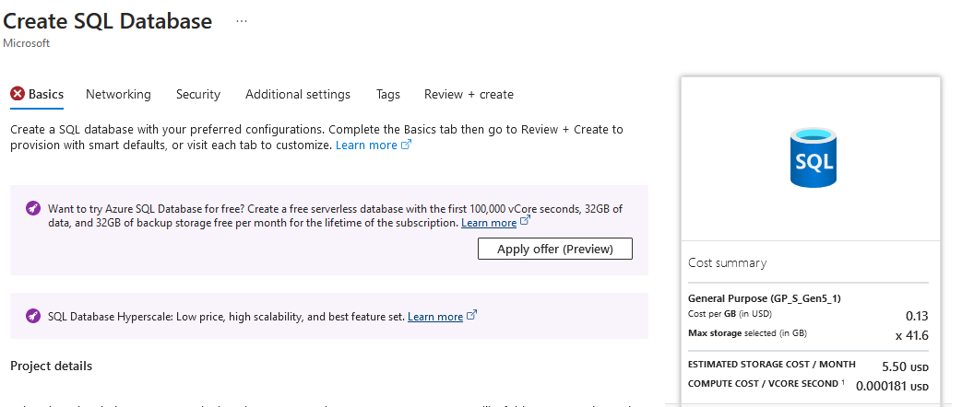

Slide 91
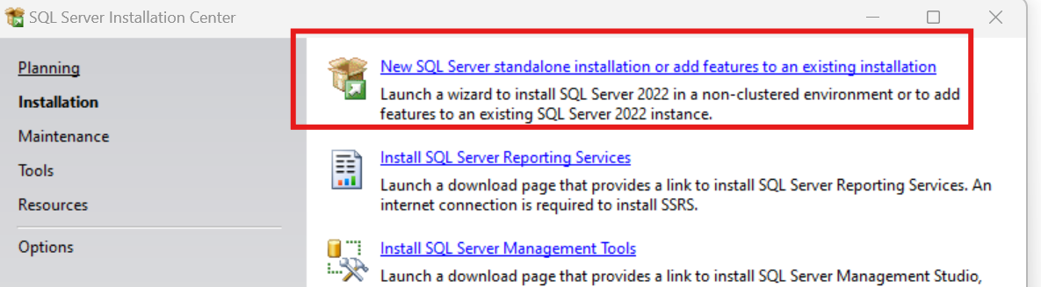
SQL Express!
https://www.microsoft.com/en-us/download/details.aspx?id=104781&lc=1033

Slide 92
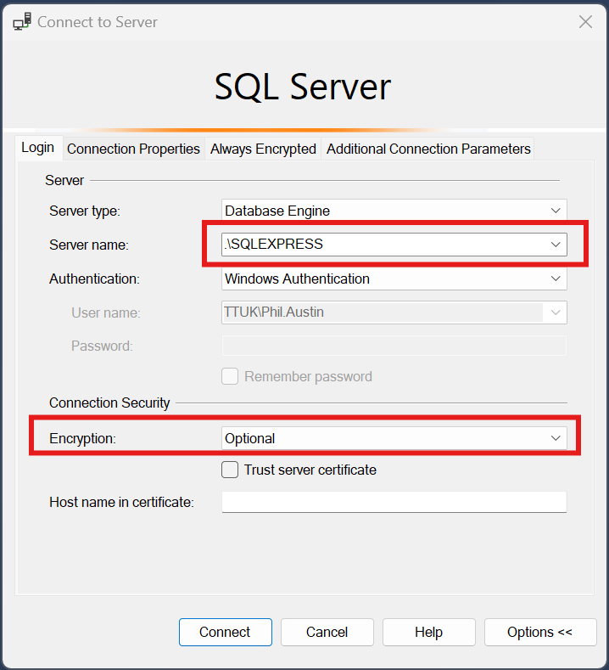

Slide 93
Download JDBC driver: https://repo1.maven.org/maven2/com/microsoft/azure/spark-mssql-connector_2.12/1.2.0/spark-mssql-connector_2.12-1.2.0.jar
Copy jar file to anaconda jars folder

Slide 94
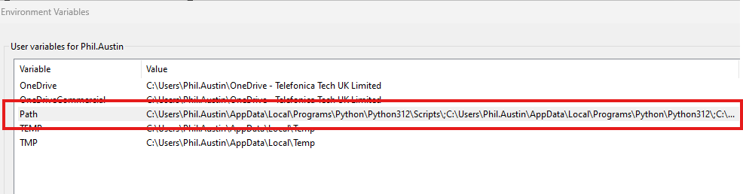
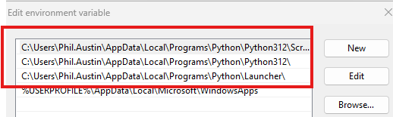
Python pre-reqs

Slide 95



Slide 96



Slide 97



Slide 98


Slide 99


Slide 100


Slide 101



Slide 102


Slide 103

Create storage account

Slide 104

Create storage account

Slide 105

Create storage account

Slide 106



Slide 107


Create Azure Data Factory (ADF)

Slide 108
Create Azure Data Factory (ADF)

Slide 109

Create Azure Data Factory (ADF)

Slide 110


Slide 111


Slide 112


Slide 114
PySpark

